Slide 1

https://sahibulsaif.wordpress.com/wisdom/bismillah-nature/

Slide 2
Dml – select statement
CSC271 – DATABASE SYSTEMS

Slide 3
PREVIOUS LECTURE

Slide 4
Today’s Lecture
SQL SELECT
Row Filtering
Operators
Comparison operators
String & Set operators
Logical operators

Slide 5
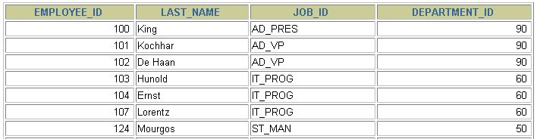

Limiting Rows Using a Selection
EMPLOYEES
…
“retrieve all employees in department 90”

Slide 6
Limiting the Rows Selected
Restrict the rows returned by using the WHERE clause.
The WHERE clause follows the FROM clause.
SELECT *|{[DISTINCT] column|expression [alias],...}
FROM table
[WHERE condition(s)];

Slide 7

Using the WHERE Clause
SELECT employee_id, last_name, job_id, department_id
FROM employees
WHERE department_id = 90 ;

Slide 8
Character Strings and Dates
Character strings and date values are enclosed in single quotation marks.
Character values are case sensitive, and date values are format sensitive.
The default date format is DD-MON-RR.
SELECT last_name, job_id, department_id
FROM employees
WHERE last_name = 'Whalen';

Slide 9
Comparison Conditions
Operator
=
>
>=
<
<=
<>
Meaning
Equal to
Greater than
Greater than or equal to
Less than
Less than or equal to
Not equal to

Slide 10

Using Comparison Conditions
SELECT last_name, salary
FROM employees
WHERE salary <= 3000;

Slide 11
Other Comparison Conditions
Operator
BETWEEN ...AND...
IN(set)
LIKE
IS NULL
Meaning
Between two values (inclusive),
Match any of a list of values
Match a character pattern
Is a null value

Slide 12
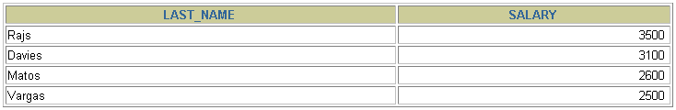
Using the BETWEEN Condition
Use the BETWEEN condition to display rows based on a range of values.
SELECT last_name, salary
FROM employees
WHERE salary BETWEEN 2500 AND 3500;
Lower limit
Upper limit

Slide 13
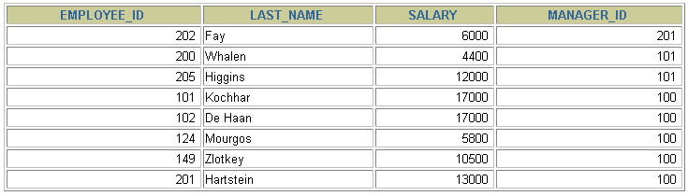
Using the IN Condition
Use the IN membership condition to test for values in a list.
SELECT employee_id, last_name, salary, manager_id
FROM employees
WHERE manager_id IN (100, 101, 201);

Slide 14
Using the LIKE Condition
Use the LIKE condition to perform wildcard searches of valid search string values.
Search conditions can contain either literal characters or numbers:
% denotes zero or many characters.
_ denotes one character.
SELECT first_name
FROM employees
WHERE first_name LIKE 'S%';

Slide 15

Using the LIKE Condition
You can combine pattern-matching characters.
You can use the ESCAPE identifier to search for the actual % and _ symbols.
SELECT last_name
FROM employees
WHERE last_name LIKE '_o%';

Slide 16
Using the NULL Conditions
Test for nulls with the IS NULL operator.
SELECT last_name, manager_id
FROM employees
WHERE manager_id IS NULL;

Slide 17
Logical Conditions
Operator
AND OR
NOT
Meaning
Returns TRUE if both component conditions are true
Returns TRUE if either component condition is true
Returns TRUE if the following condition is false

Slide 18

Using the AND Operator
AND requires both conditions to be true.
SELECT employee_id, last_name, job_id, salary
FROM employees
WHERE salary >=10000
AND job_id LIKE '%MAN%';

Slide 19
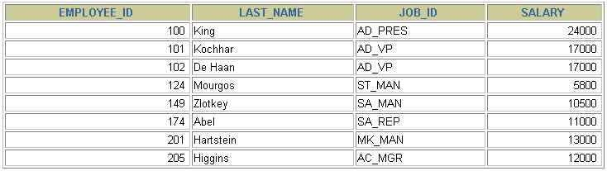
Using the OR Operator
OR requires either conditions to be true.
SELECT employee_id, last_name, job_id, salary
FROM employees
WHERE salary >= 10000
OR job_id LIKE '%MAN%';

Slide 20
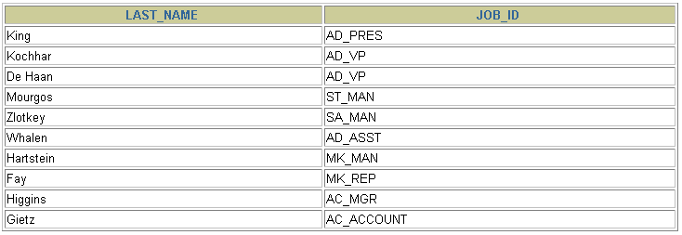
Using the NOT Operator
SELECT last_name, job_id
FROM employees
WHERE job_id
NOT IN ('IT_PROG', 'ST_CLERK', 'SA_REP');

Slide 21
Rules of Precedence
Order Evaluated Operator
1 Arithmetic operators
2 Concatenation operator
3 Comparison conditions
4 IS [NOT] NULL, LIKE, [NOT] IN
5 [NOT] BETWEEN
6 NOT logical condition
7 AND logical condition
8 OR logical condition
Override rules of precedence by using parentheses.

Slide 22
Rules of Precedence
SELECT ProductID, ProductModelID
FROM Product
WHERE ProductModelID = 20 OR
ProductModelID = 21 AND Color = 'Red'

Slide 23
Using parenthesis
SELECT ProductID, ProductModelID
FROM Product
WHERE (ProductModelID = 20 OR ProductModelID = 21)
AND Color = 'Red'

Slide 24

http://www.thomasformo.com/category/qa/

